Slide 1

“HANDWRITTEN DIGIT RECOGNITION USING DEEP LEARNING”
by
MUHAMMAD SAALIM USN: 23BTRCL019

Slide 2
INTRODUCTION
In the modern era of automation and artificial intelligence, the ability to recognize and interpret handwritten text has become an essential technological advancement. Handwritten digit recognition is widely used in various applications, including banking systems for check verification, postal services for automatic mail sorting, and educational platforms for digitizing handwritten notes. Traditional methods of digit recognition relied on rule-based algorithms and pattern-matching techniques, which often struggled to handle variations in handwriting styles, orientations, and distortions.
Handwritten digit recognition is a crucial task in cuter vision, enabling automation in areas such as banking, postal services, and document processing. The goal of this project is to develop an efficient and accurate digit recognition system using deep learning techniques. By leveraging Convolutional Neural Networks (CNNs), the system is trained to identify and classify handwritten digits with high precision. The model is integrated into a web-based application using Flask, allowing users to upload images and receive real-time predictions. This project not only demonstrates the effectiveness of deep learning in pattern recognition but also highlights its potential for real-world applications where digit classification plays a vital role.

Slide 3
SCOPE
The scope of this project extends beyond simple digit recognition by exploring the potential of deep learning in handwritten character analysis. It focuses on creating a robust and scalable system that can be expanded to recognize not just digits but also letters and symbols in the future. The project encompasses various stages, including data preprocessing, model training, web application integration, and user interaction through an intuitive interface. Additionally, it provides insights into the advantages of deep learning over traditional machine learning approaches in image-based classification tasks.
OBJECTIVE
The primary objectives of this project are to develop a deep learning model that can accurately classify handwritten digits, preprocess input images to match the dataset format, and deploy the trained model as a user-friendly web application using Flask. The project aims to bridge the gap between theoretical deep learning concepts and their practical implementation, ensuring real-time usability. Furthermore, it seeks to optimize model performance for higher accuracy and explore future improvements such as multilingual handwriting recognition and lightweight deployment for mobile and embedded devices.

Slide 4
Image Processing Techniques
Before feeding handwritten digit images into the model, preprocessing is essential to enhance accuracy. The system applies various techniques, including grayscale conversion, normalization, noise reduction, and resizing to 28x28 pixels, the standard input size for CNN-based digit recognition. Edge detection techniques, such as Sobel filtering, can also be used to improve feature extraction.
Advantages of Deep Learning in Digit Recognition
Deep learning, specifically CNNs, provides superior performance in image classification tasks. Unlike traditional machine learning methods that require handcrafted features, CNNs automatically learn spatial hierarchies of features. This results in higher accuracy, robustness to variations in handwriting styles, and adaptability to new datasets without extensive feature engineering. CNN-based recognition systems also outperform rule-based and template-matching approaches in digit classification

Slide 5
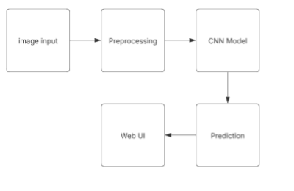
Architecture Diagram

Slide 6
Hardware Requirements
For training the CNN model, high-performance hardware is recommended:
Processor: Intel i7 or higher / AMD Ryzen 7 or higher
RAM: 16GB or more
GPU: NVIDIA RTX 3060 or higher (for faster model training)
Storage: 500GB SSD (to store datasets and models efficiently)
For deployment, the system can run on a standard server or cloud environment with moderate computing power.
Dataset Description
The project uses the EMNIST (Extended MNIST) dataset, a larger variant of the MNIST dataset that includes handwritten digits and letters. The dataset consists of:
Train Set: 240,000 images, Test Set: 40,000 images, Image Size: 28×28 pixels (grayscale), Classes: 10 (digits 0-9)
Each image in the dataset is preprocessed to normalize pixel values between 0 and 1, ensuring faster convergence during training.

Slide 7
Python Libraries Used
TensorFlow/Keras: TensorFlow is an open-source deep learning framework developed by Google. Keras, an API built on top of TensorFlow, is used to construct and train the Convolutional Neural Network (CNN) model.
NumPy: A fundamental library for numerical computations in Python, used for handling multi-dimensional arrays.
Pandas: A data manipulation and analysis library that helps in handling structured data.
Matplotlib & Seaborn: These are visualization libraries used to plot dataset distributions, accuracy graphs, and loss curves.
OpenCV: A library used for image processing tasks such as resizing, grayscale conversion, and thresholding.
Flask: A lightweight Python web framework used to create the backend for deploying the digit recognition model as a web application.
PIL (Pillow): A library used for opening, manipulating, and converting images

Slide 8
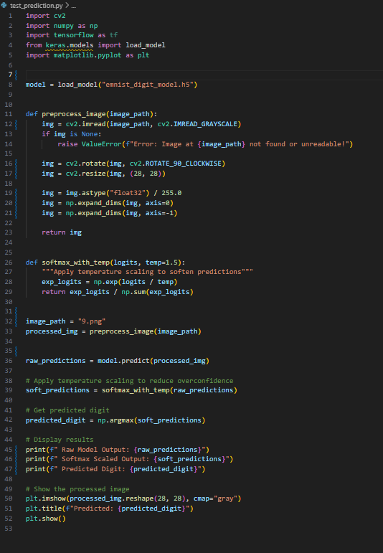
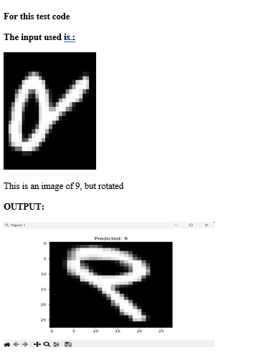
Sample code:

Slide 9
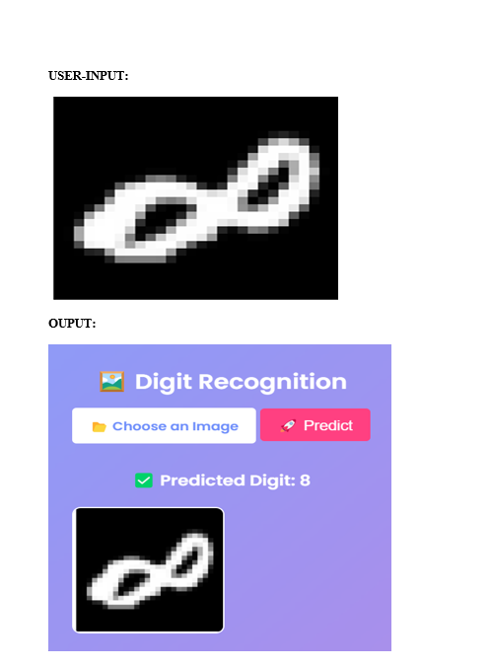
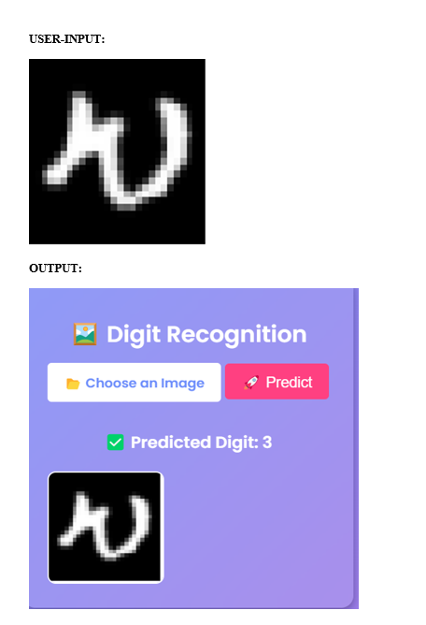

Slide 10
Conclusion
The implementation of the digit recognition system successfully demonstrates the power of deep learning in image classification. By leveraging a CNN model trained on the EMNIST dataset, we achieved high accuracy and real-time prediction capabilities. The project’s deployment using Flask ensures accessibility for end-users, making it a practical application of artificial intelligence in handwritten digit recognition. Future improvements may focus on increasing the dataset size, optimizing the model, and integrating additional preprocessing techniques to improve robustness.

Slide 11
THANK YOU

